Slide 1

Course Name:
COMPILER LAB
Course code:
SCS4303

Slide 2
Course Objectives
Deepen the understanding of compiler design.
To enrich the knowledge in various phases of compiler and its use, code optimization techniques, machine code generation, and use of symbol table.
To extend the knowledge of parser by parsing LL parser and LR parser.
To provide practical programming skills necessary for constructing a compiler.
To implement NFA and DFA from a given regular expression.

Slide 3
List of Experiments
Implement Token Separation for a given expression using LEX.
Use LEX tool to implement Lexical Analyzer.
Use LEX and YACC to implement parser.
Use LEX and YACC tool to implement Desktop Calculator.
Construction of NFA from a regular expression.
Construction of DFA from a regular expression.
Implement Recursive Descent Parser algorithm.
Implement Shift Reduce Parser algorithm.
Implement the frontend of the compiler to produce three address code.
Implement Symbol Table management
Construct a simple compiler.

Slide 4
FLEX FOR WINDOWS
WELCOME TO INSTALLATION AND WORKING ENVIRONMENT

Slide 5
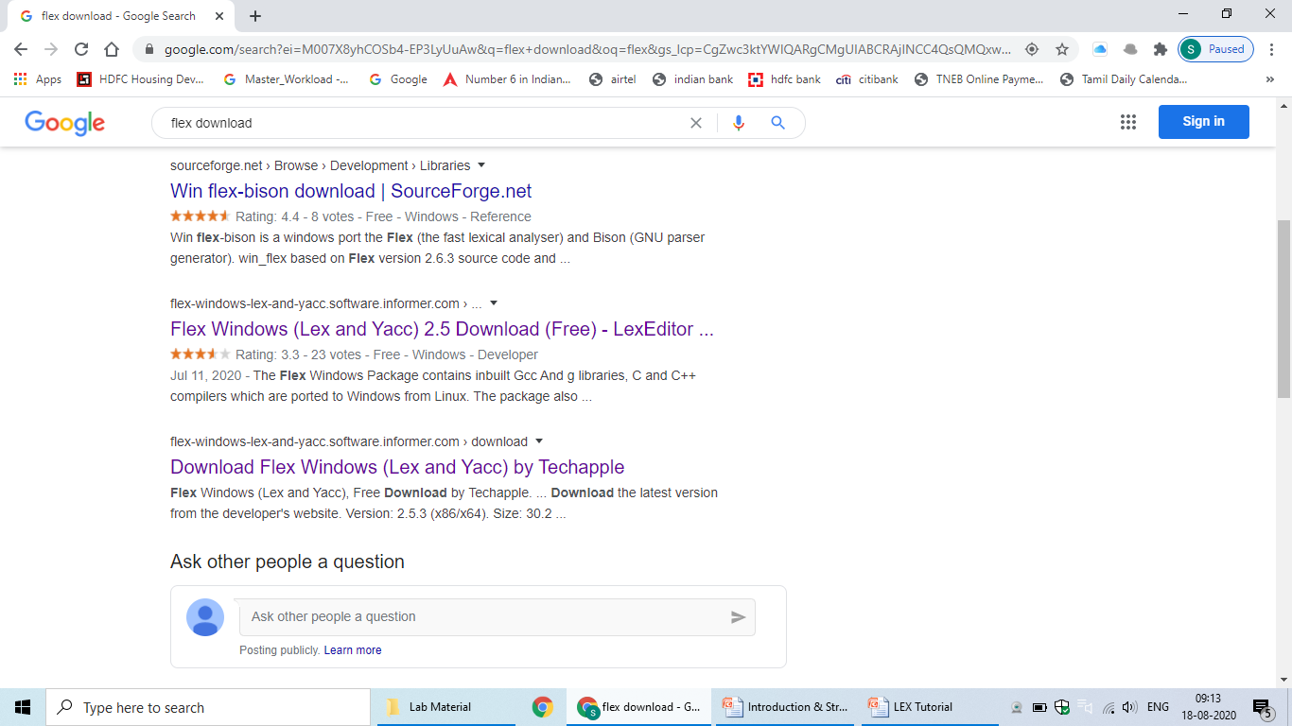

Slide 6
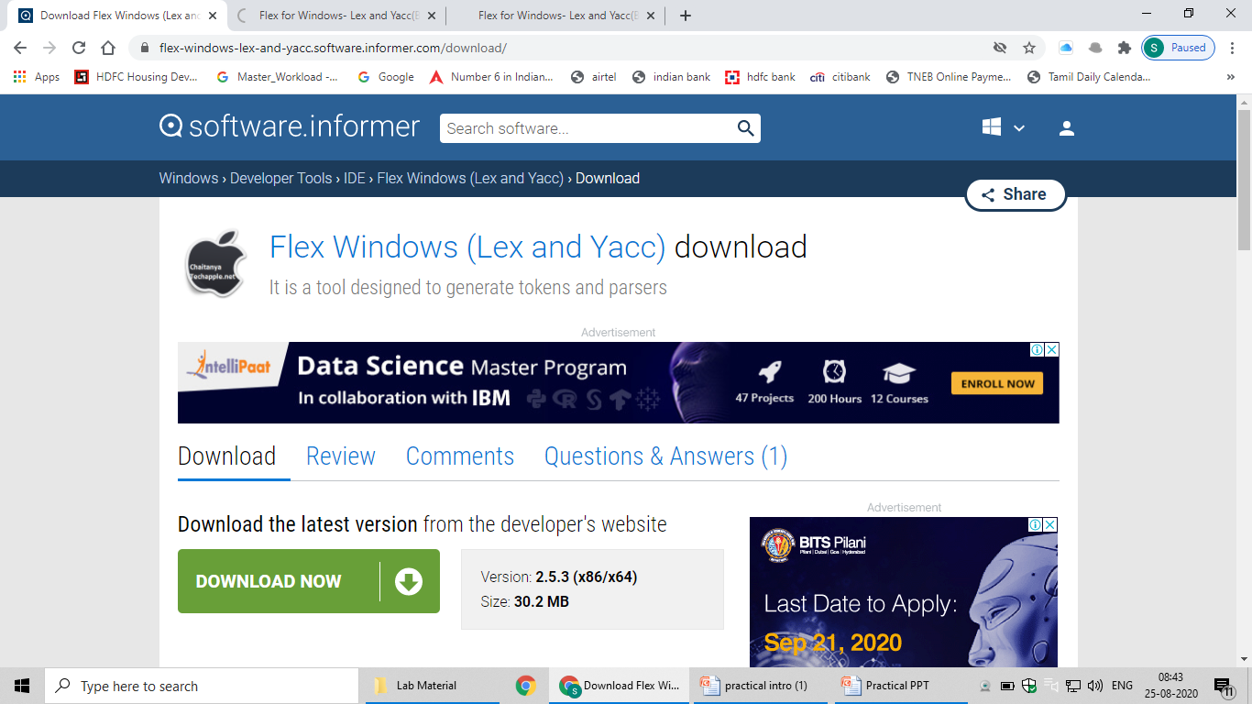

Slide 7
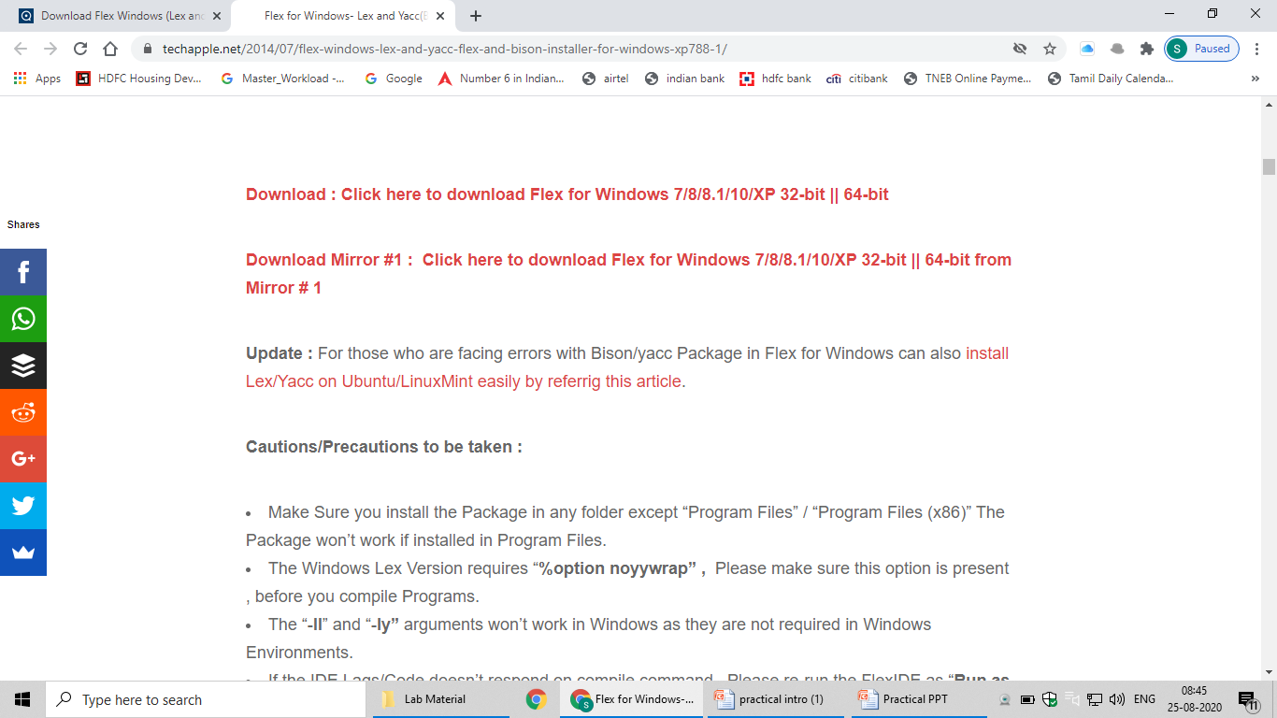

Slide 8
ALTERNATE INSTALLATION

Slide 9
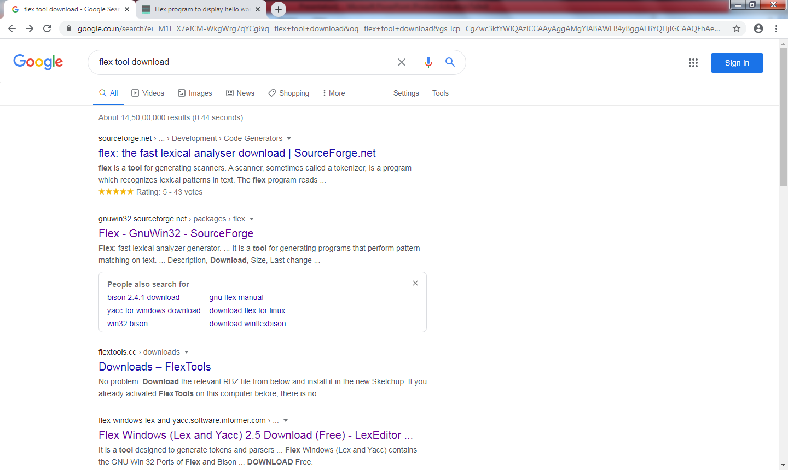

Slide 10
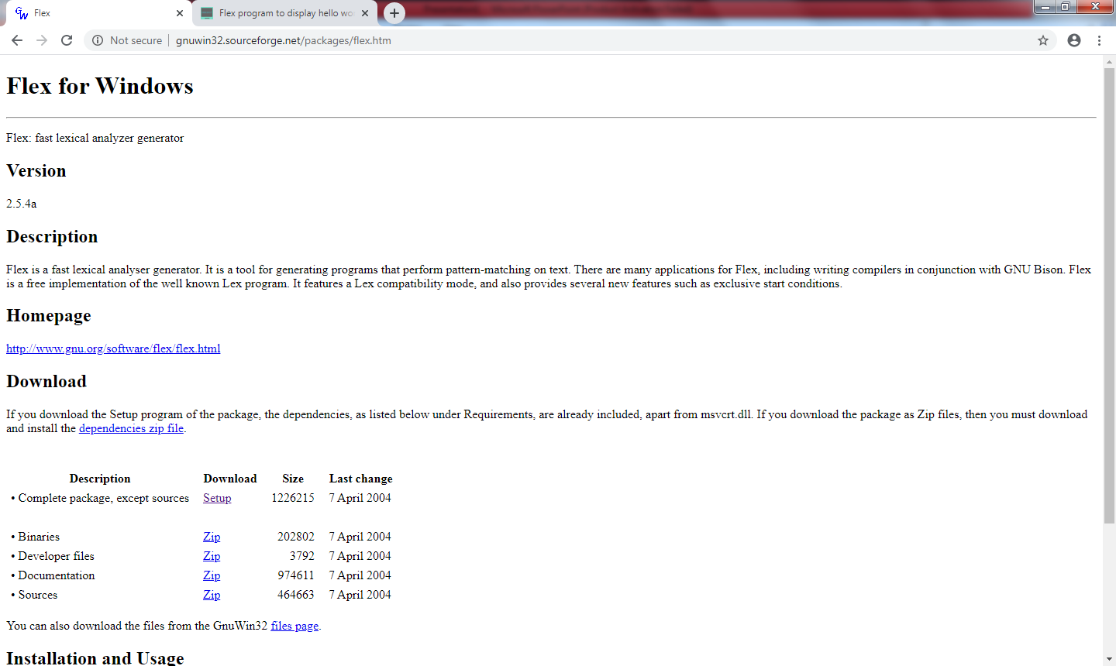

Slide 11
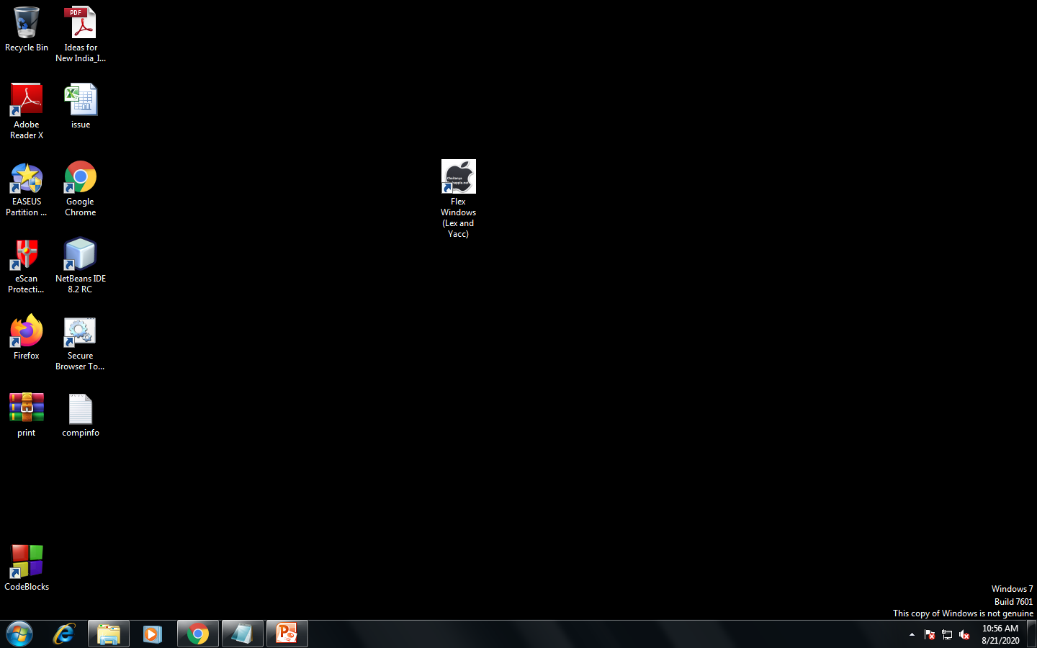

Slide 12
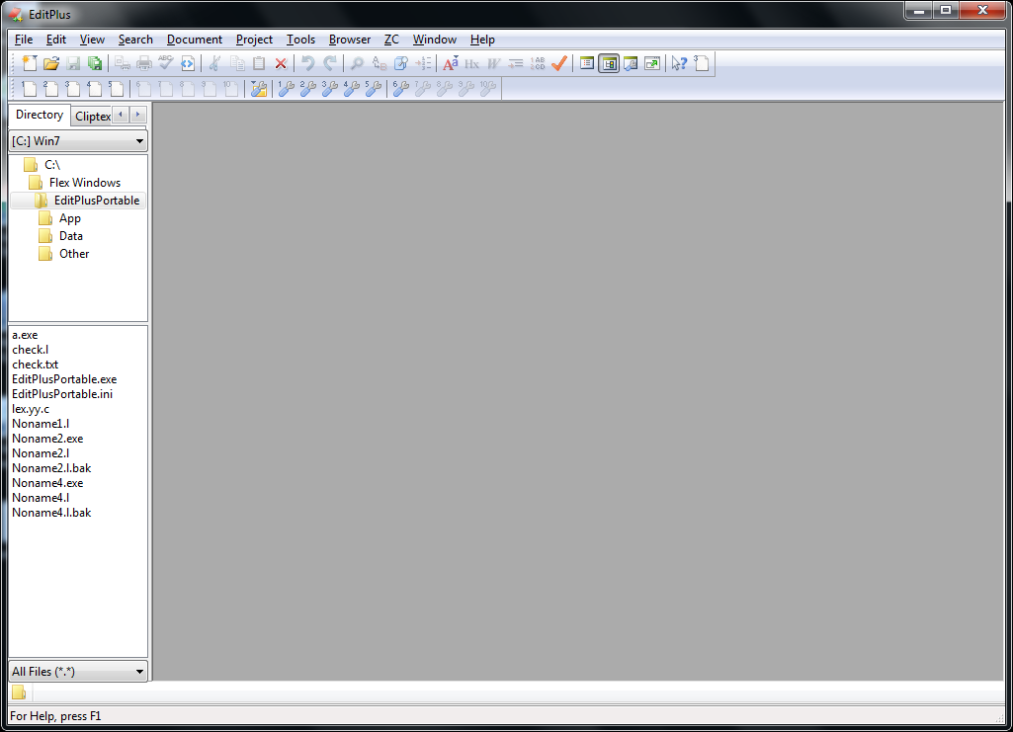

Slide 13
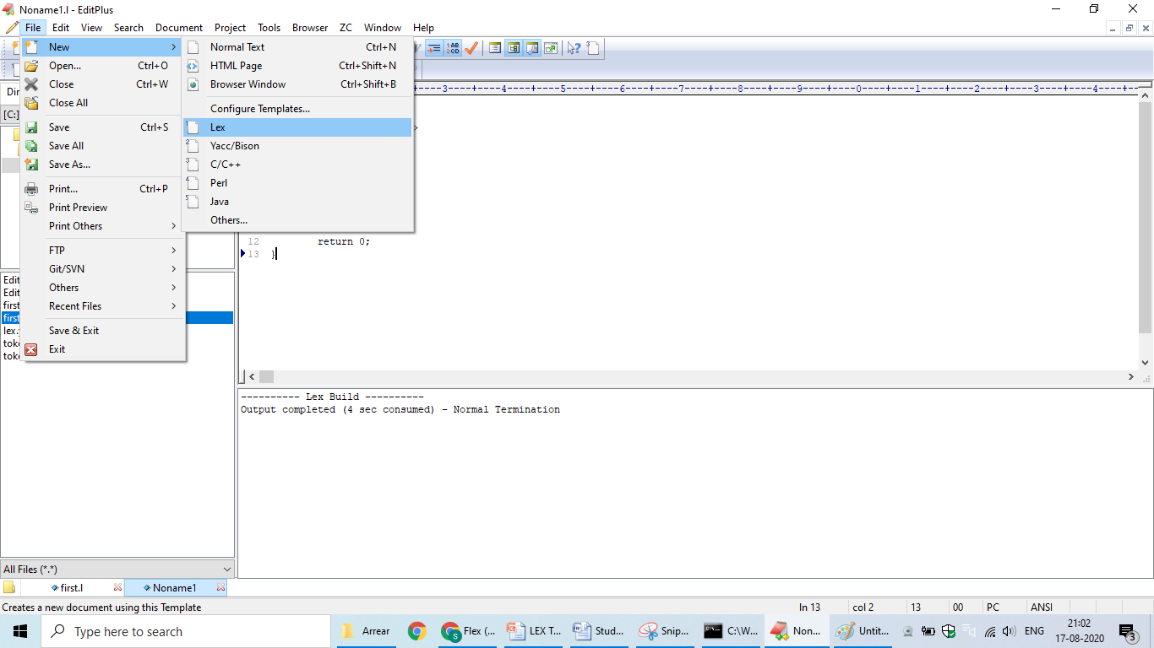

Slide 14
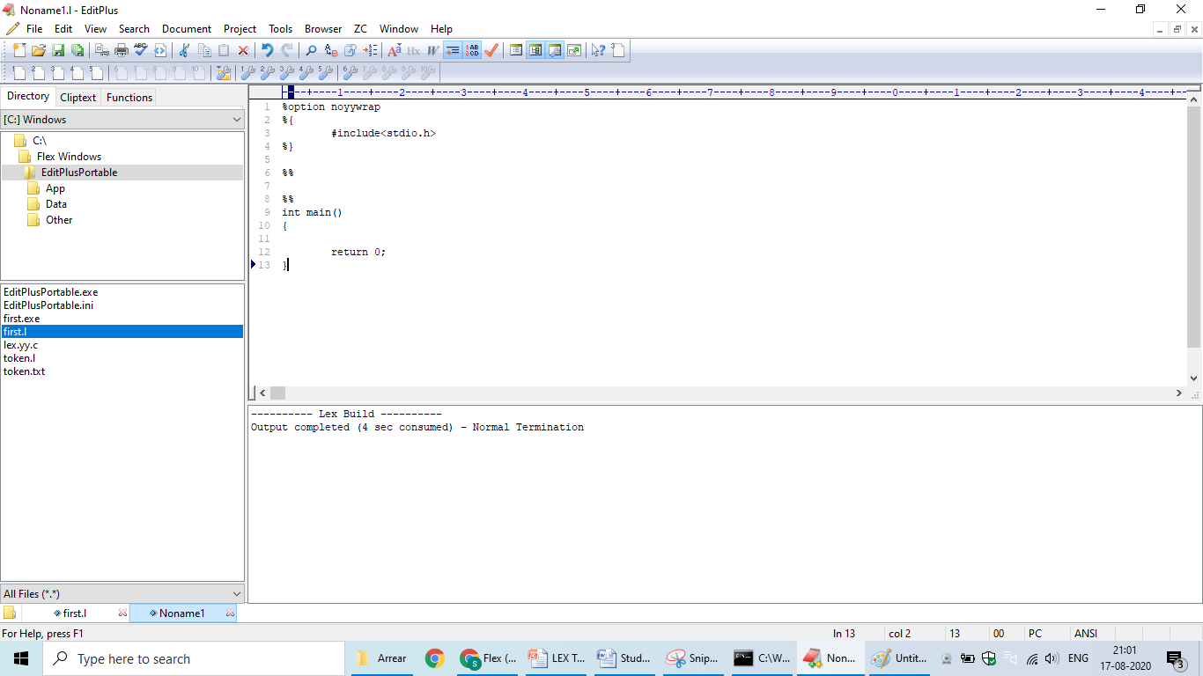

Slide 15
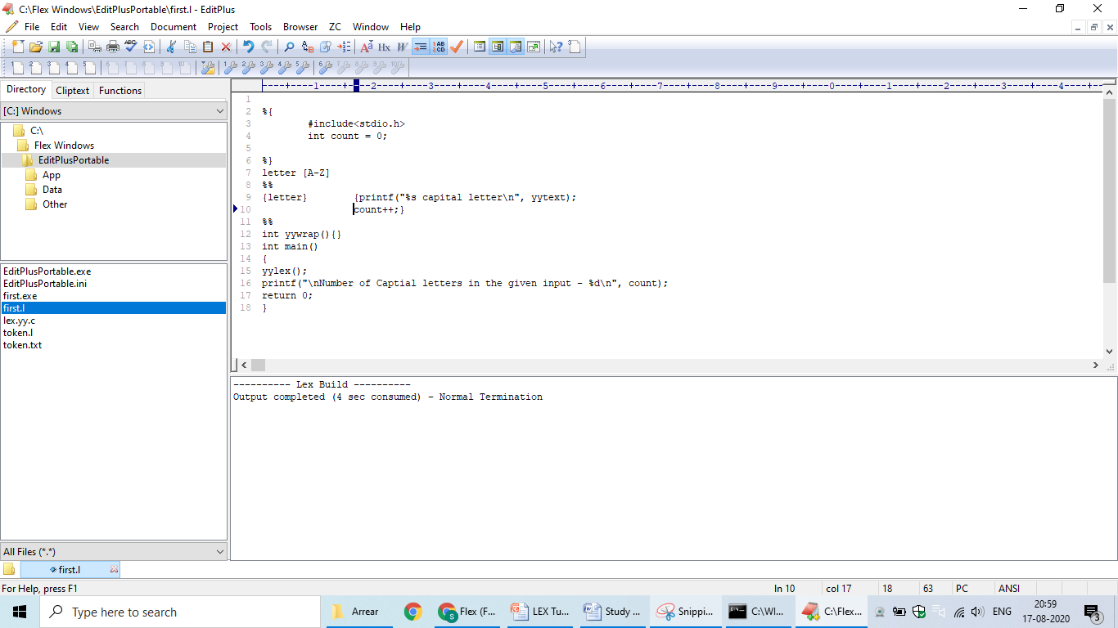

Slide 16
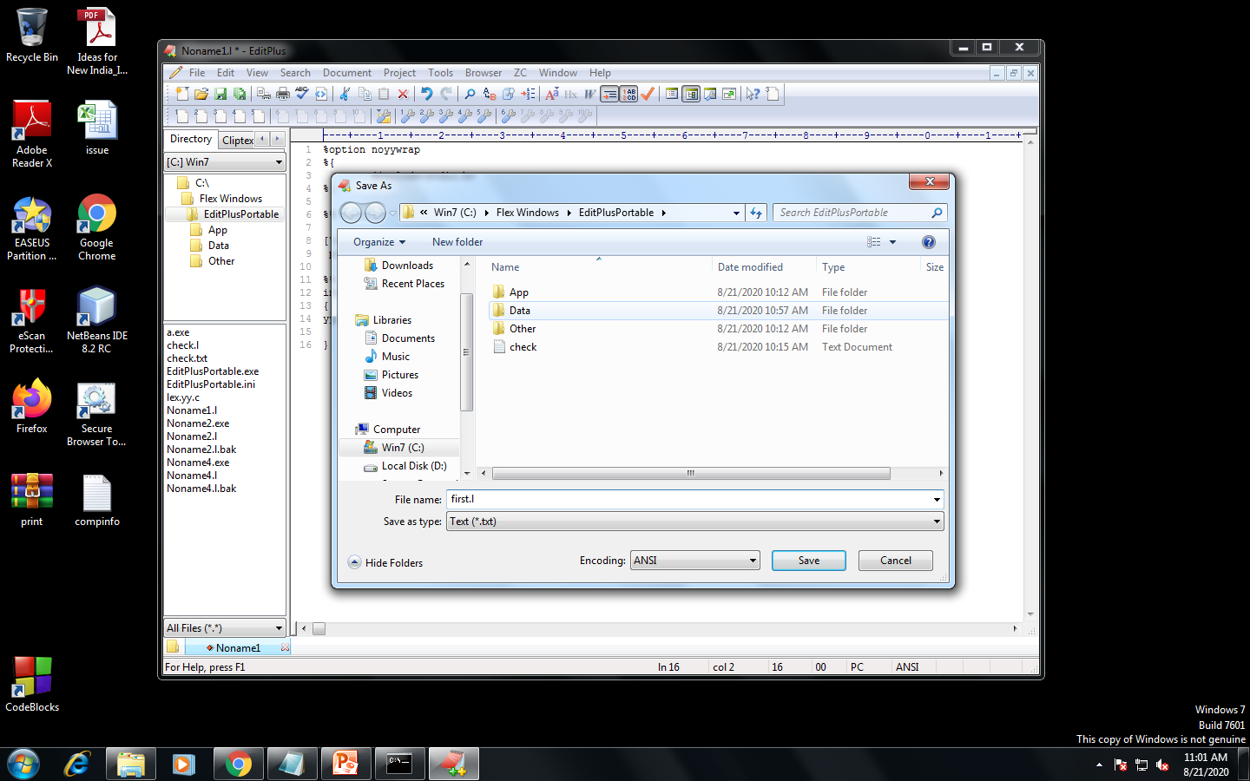

Slide 17
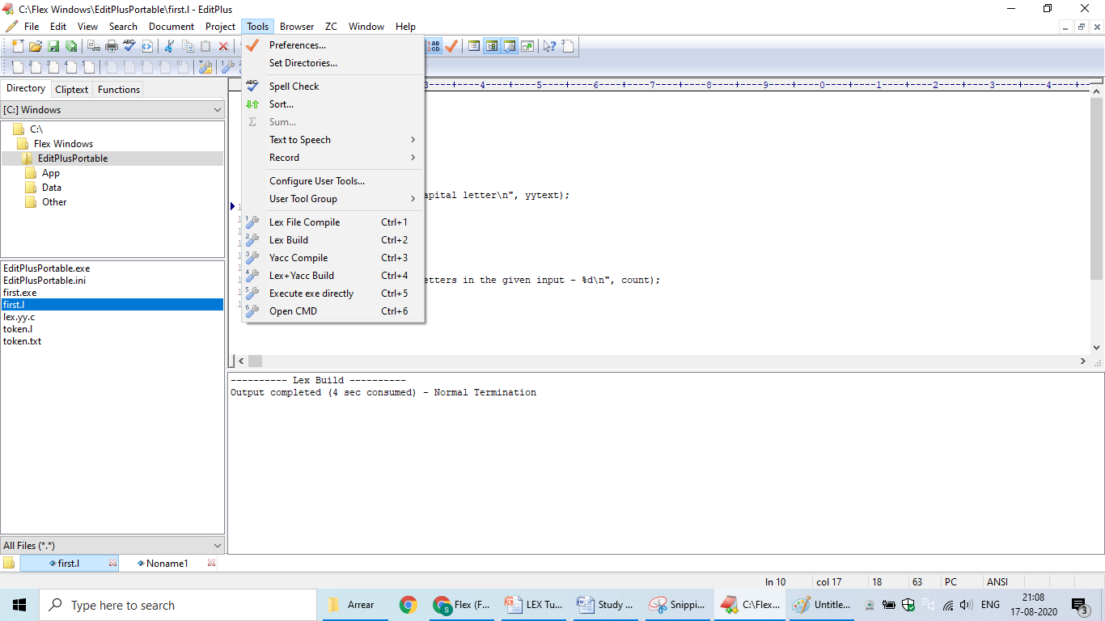

Slide 18
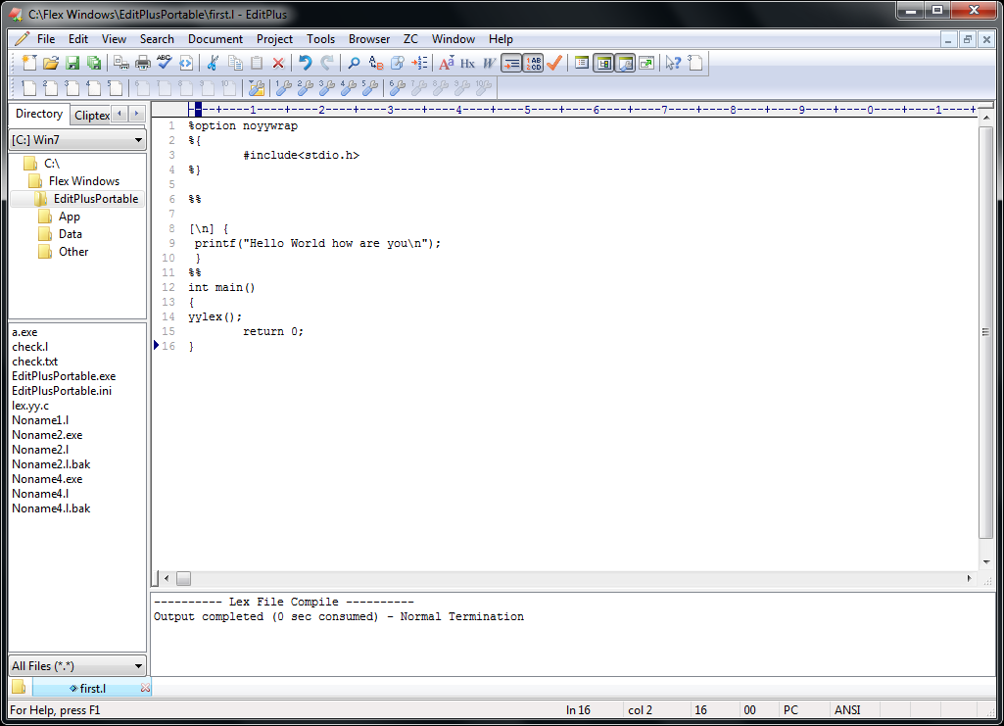

Slide 19
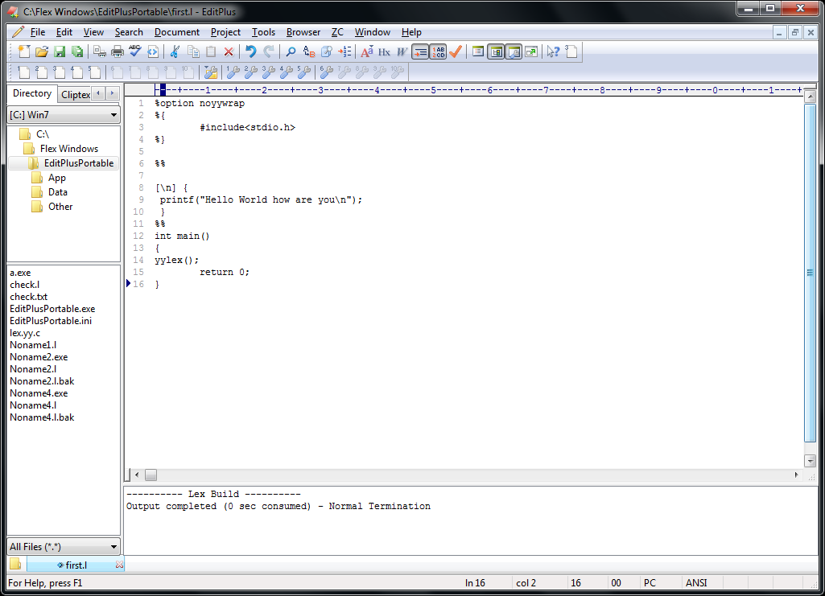

Slide 20
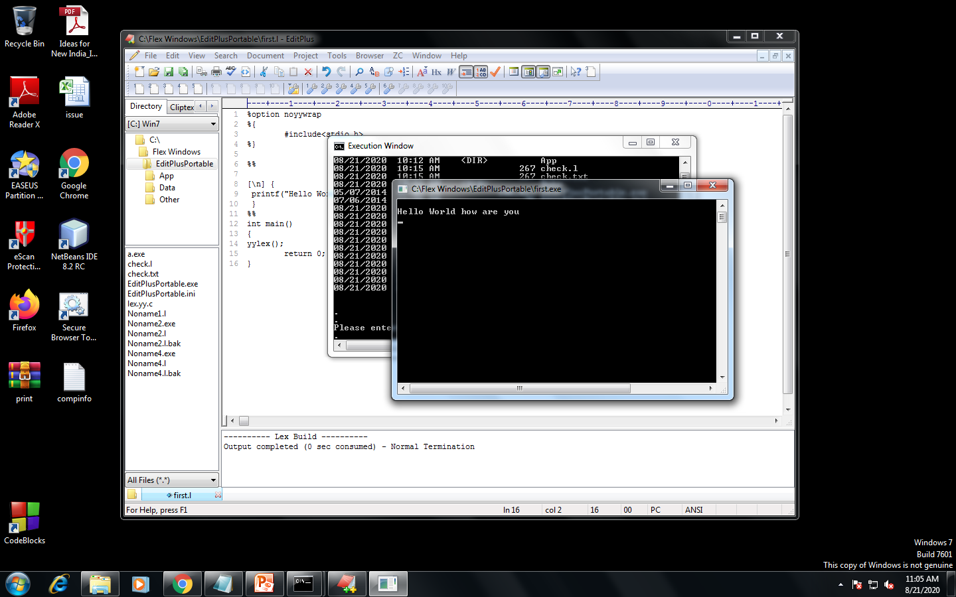

Slide 21
To count no. of lines, words , tabs and spaces
%option noyywrap
%{
#include<stdio.h>
int lc=0,tc=0,ch=0,sc=0;
%}
%%
[\n] {lc++;}
\t tc++;
[ ] sc++;
. ch++;
%%
int main()
{
yylex();
printf("Line count=%d",lc);
printf("Tab count=%d",tc);
printf("character count=%d",ch);
printf("Space count=%d",sc);
return 0;
}

Slide 22
Lex program to check whether input is digit or not.
%option noyywrap
%{
#include<stdio.h>
%}
digit [0-9]
letter [a-zA-Z]
%%
{digit}+ {printf("%s is digit",yytext);}
{letter}* {printf("%s is identifier",yytext);}
. ;
%%
int main()
{
printf("Enter the Input");
yylex();
printf("end");
return 0;
}

Slide 23
Program to check for odd or even
%option noyywrap
%{
#include<stdio.h>
int i;
%}
%%
[0-9]+ {i=atoi(yytext);
if(i%2==0)
printf("even no");
else
printf("odd no");
};
%%
int main()
{
yylex();
return 0;
}

Slide 24
Token Separation
%option noyywrap
%{
#include<stdio.h>
void yyerror(char *);
%}
letter [a-zA-Z]
digit [0-9]
op [-+*]
%%
else|int|float {printf("%s is a keyword",yytext);}
{digit}+ {printf("%s is a number",yytext);}
{letter}({letter}|{digit})* {printf("%s is an identifier",yytext);}
{op} {printf("%s is an operator",yytext);}
. yyerror("error");
%%
void yyerror(char *s)
{
fprintf(stderr,"%s\n",s);
}
int main()
{
yylex();
return 0;
}

Slide 25
EXERCISE
Write a lex program to identify token using lex tool.

